Slide 1
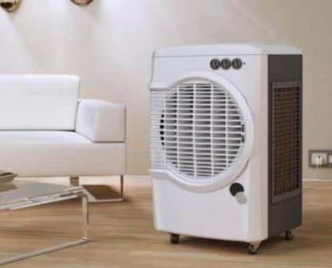
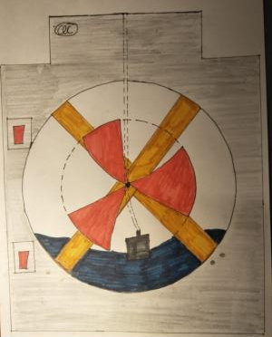
Cresta Cooler
Its time to be a ruler, install the Cresta Cooler

Slide 2
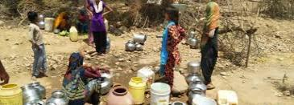


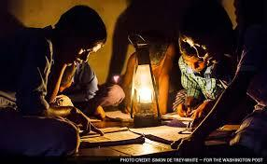
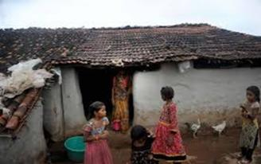
The Problem

Slide 3
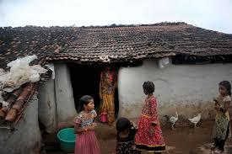
The Problem
Indian villages face large gap between electricity demand and supply.
Only 1,417 (7.3%) of the 18,452 villages have 100% electrical connectivity; 31 million homes still without electricity.
Temperatures are nearing 50⁰ c in some parts of the nation.
There is a need for a cost effective cooling mechanism that can be used even in the absence of electricity supply.
The Cresta Cooler is a perfect solution to this problem

Slide 4
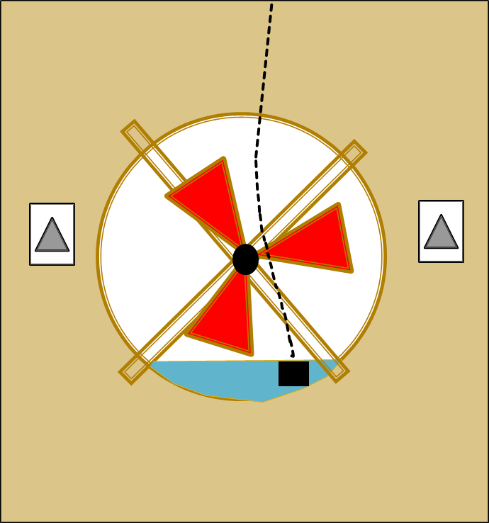
About the Product
Cooler made from recycled and easily available materials.
Provides cooling comfort in hot areas with no or minimal electricity supply
Low cost to own and use
“Cresta Cooler”

Slide 5
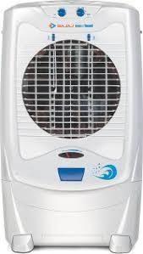


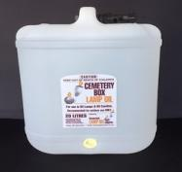

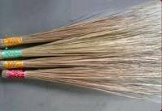
Waste Materials Used
The Cresta Cooler is essentially a cooler that is made up of waste materials that include:
  Plastic oil box (50 litre)
  Ice-cream sticks, Twigs, broom fibers, jute
  Cardboard
1
2
3

Slide 6

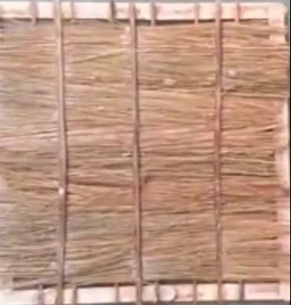
Cresta Cooler overview
Front View
Rear View
Water distribution tube
Thick cardboard support
Switch
For Motor
Fan connected to DC motor
Switch
For Pump
DC Water Pump
Cooler box
Cooler pad

Slide 7
DETAILS OF THE PRODUCT

Slide 8
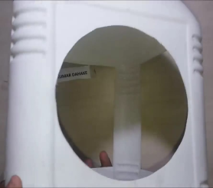
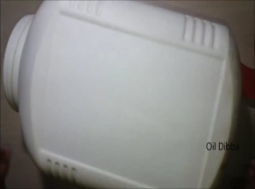

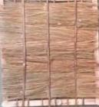
The Body of the Cooler
Body: 4-sided 50 litre oil box
Front side: Circular opening + Plastic fan blades
Rear side: Rectangular opening + Cooler Pad
Oil Box body
Front Side
Rear Side

Slide 9

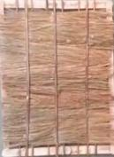
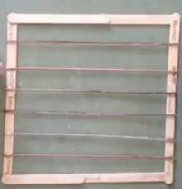
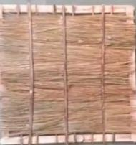
Cooler Padding
Rear View
Broom fiber
Jute fiber
Frame for Cooler Pad
The frame is made using ice-cream sticks and twigs filled with broom fiber/ jute

Slide 10
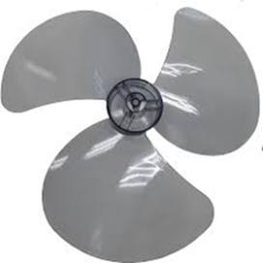
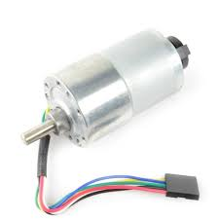
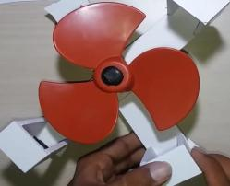

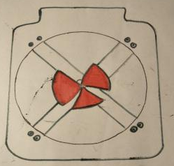
The Fan
Cardboard support
Fan Blades
DC Motor
Front View
The fan is attached to the DC motor and fixed inside the circular opening

Slide 11
Functioning of The Cooler
Top of the box sealed with cardboard
Water distribution tube connected from top of box to pump
Submersible DC water pump placed inside the cooler body.
DC Water Pump and DC Fan Motor connected by wires to separate switches mounted on cooler body.
Power source is 12 V battery.
Wires from Switch
12 V battery
Wire from Motor
Wire from Pump
Wiring of the cooler

Slide 12
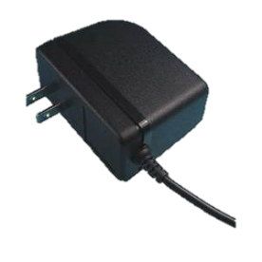
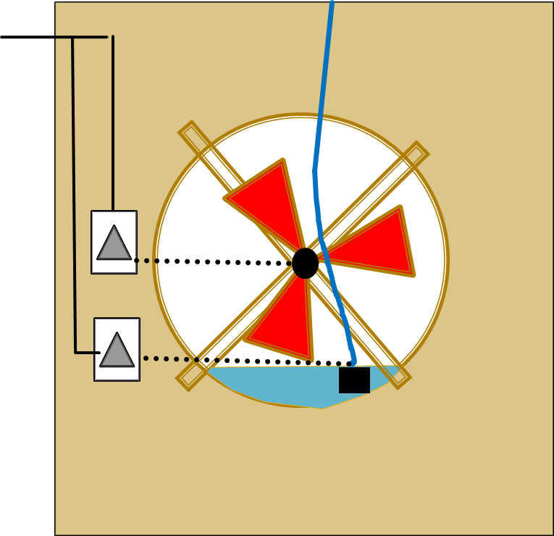
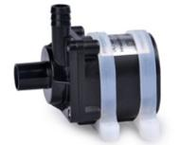
How it provides Cooling?
Water is added from the front or rear side.
Pump circulates water to reduce temperatures
If there is electricity an adaptor can be used in place of a battery .
Switching mode adaptor
DC water Pump
Water added from front

Slide 13
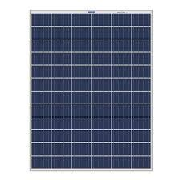
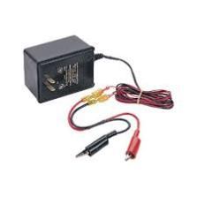
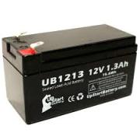
Battery Recharging
For the villages without any electricity we plan to set up a charging station which will comprise of 12V battery chargers with a 12V solar panel being the power source
12 V Solar panel( Power Source)
Battery charger
Recharged Battery

Slide 14
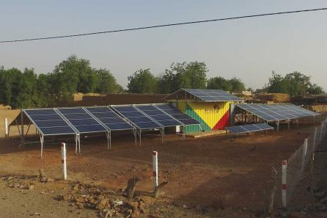
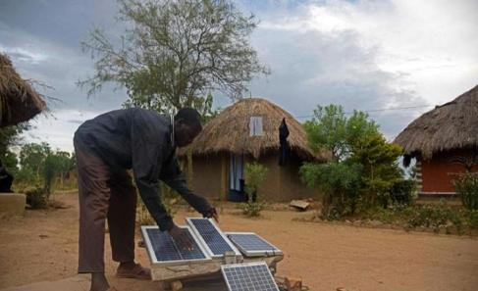
Recharging Booth

Slide 15
Conversion of Waste
1. A plastic oil box is reused as the body of the cooler
2.Ice- cream sticks and twigs are used to make the frame of the cooler pad
3.Broom fiber/ Jute is used to fill the pad
4.Waste cardboard is used for the support of the fan structure and to seal the top part of the cooler body

Slide 16
Pricing (Per Unit)
COMPANY | ITEM | COST ( in ₹)
Waste Material | Cooler padding | -
Waste Material | Plastic Oil Box and Cardboard | -
Human Resource | Labour charges | 10
MX | Wires and screws | 5
Coolio | Blades | 10
GKR Plastic | Fan Blade | 15
KitsGuru | DC Water Pump (Submersible) | 60
Generic | DC Motor | 80
Generic | 12 V Battery (Rechargeable) | 50
Legal fee | Patent | 50
TOTAL |  | 280

Slide 17
Financials
 | Year 1 (2018-2019) | Year 2 (2019-2020) | Year 3 (2020-2021 )
Revenue (Total Sales) | 75,00,000 | 1,50,00,000 | 2,25,00,000
Operating Expenses | 3,50,000 | 7,00,000 | 10,50,000
Salaries | 30,00,000 | 60,00,000 | 90,00,000
Marketing (Ads) | 20,00,000 | 30,00,000 | 40,00,000
Production Unit - Rent | 10,00,000 | 20,00,000 | 30,00,000
Legal fees (Patents) | 50,000 | 75,000 | 1,00,000
Motor (DC water pump + DC motor) | 7,00,000 | 14,00,000 | 21,00,000
Wires, Screws, Blades, Battery | 3,25,000 | 6,50,000 | 9,75,000
Charging Booth (Set-up) | 6,00,000 | 12,00,000 | 18,00,000
Total Expenses | 78,75,000 | 1,50,25,000 | 2,20,25,000
 | (-3,75,000) | (-25,000) | 4,75,000

Slide 18
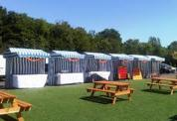




Marketing Strategies
Considering the fact that our target consumers primarily include the rural poor, we plan to:
Distribute pamphlets in 10 villages particularly in Uttar Pradesh, Punjab and Bihar.
Publish advertisements in local newspapers and radio.
Launch advertisements under the label of Ministry of Rural Development, India under the “ Pradhan Mantri Sahaj Bijli Har Ghar Yojana”
Launch an online marketing campaign and a PR campaign.

Slide 19
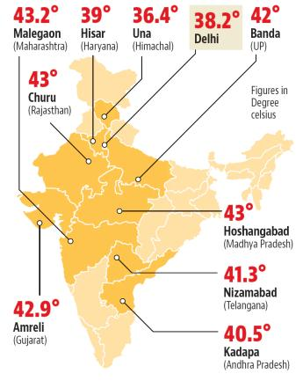
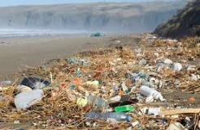
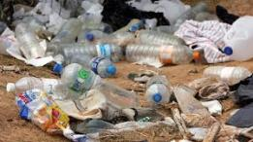
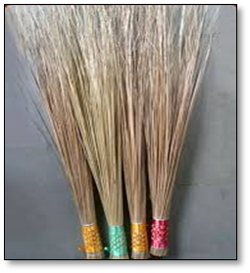

Impact on Environment

Slide 20
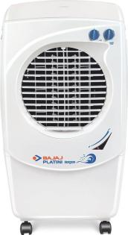
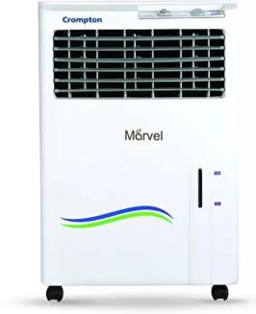
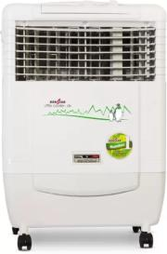
Competitors
Cost- ₹4500
Cost- ₹4199
Cost- ₹6950
Bajaj
Bajaj Coolers
Ken Star Cooler
Crompton Coolers

Slide 21

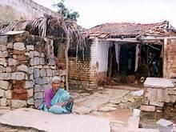


Welfare of people

Slide 22
It is time to join Team Cresta
Thank You

